Slide 1
CIS117 Week 9
Shellscripting, now with variables

Slide 2
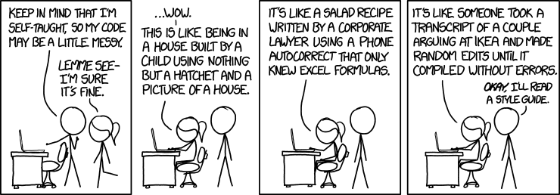
Beyond the basics
Getting keyboard input
Variables
Variables in Linux are untyped
Any word (that isn't reserved) can be a variable
Use $ to use variable
https://www.explainxkcd.com/wiki/index.php/1513:_Code_Quality

Slide 3
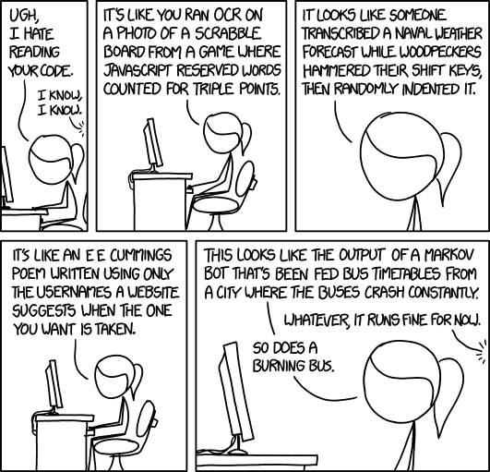
DEMO
Small script asking for name and then saying hello $name
#!/bin/bash
Echo "What's your name?"
Read name
Echo "Hello $name"
https://www.explainxkcd.com/wiki/index.php/1695:_Code_Quality_2

Slide 4
Positional parameters
Used to pass info to a script when executed
Numbered starting at 1 with some special parameters (such as $* and $?)
Example and DEMO
./testscript.sh Jane #puts Jane as $1
echo "hello $1" #should say hello Jane
./testscript.sh Jane Doe #should put Jane as $1 and Doe $2
echo "hello $1 $2" # should say hello Jane Doe

Slide 5
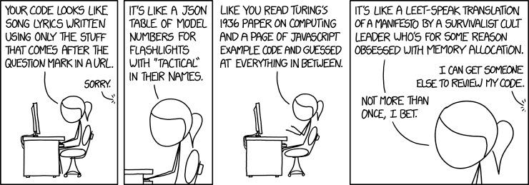
Special use case positional parameters and backticks
Command of date
Then use set `date` (backticks not single quote)
Puts the results in positional parameters
DEMO use case
https://www.explainxkcd.com/wiki/index.php/1833:_Code_Quality_3

